Slide 1
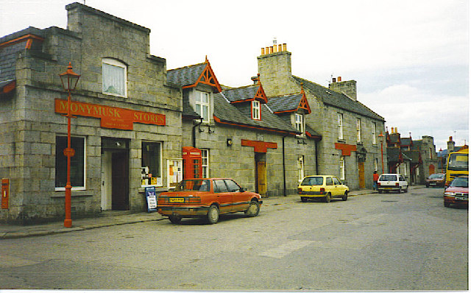
Monymusk Multi Terrain
Half Marathon
Sunday 27th October 2013, 11am Village Hall
Sponsored by: Grant Arms Hotel, The Running Shop, Run4IT
Entry on the day £10 - Proceeds to charity
Contact: Rob Brookes - brookesrobert@hotmail.com or cosmics.org.uk

Slide 2
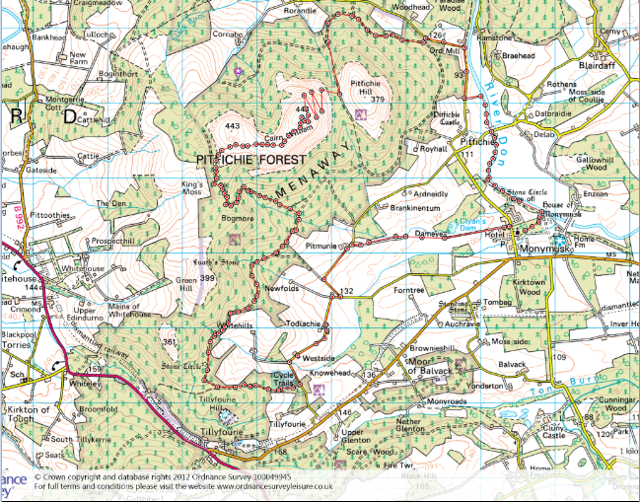
Monymusk Multi Terrain
Half Marathon
13.1m/21.1km
Sun 27th October 2013
Registration closes 1030am
£10 Entry
11am Race Start
Tea & cake to finish
Individual/Team/Spot prizes
START
Finish

